Slide 1
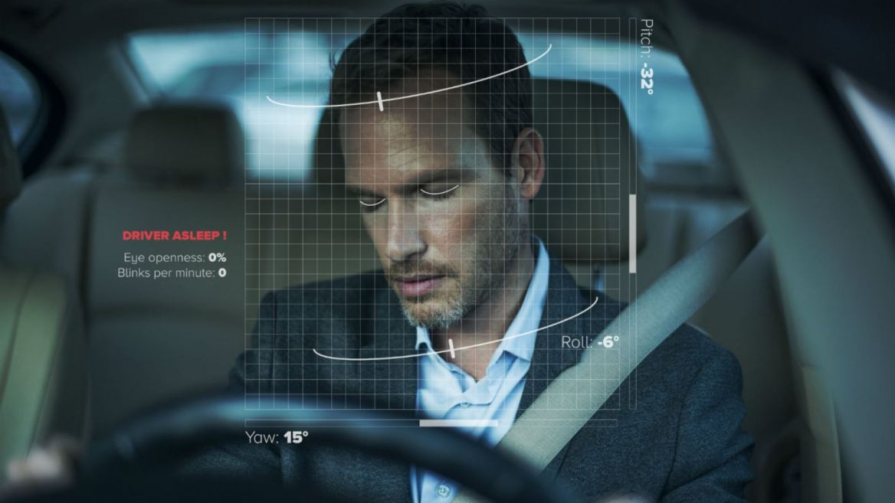
DROWSINESS DETECTOR
GROUP 4-
YASH PATWARDHAN (23361)
VEDANT DESHPANDE(23362)
AMAAN NAIKAWADI(23363)
ADITYA KANGUNE(23365)

Slide 2
PROBLEM STATEMENT
Drowsy and fatigue driving is a major transportation safety concern and is responsible for thousands of accidents and numerous fatalities every year.
Drowsy driving crashes are usually of high severity due to the drivers’ significant loss of control, often leading to unpredicted vehicle trajectory and no braking response.
The most important challenge is to detect the driver’s condition sufficiently early, prior to the onset of sleep, to avoid collisions.
It can be used by riders who tend to drive for a longer period of time that may lead to accidents.

Slide 3
OUR SOLUTION
The main purpose of this project is to develop a prototype of Drowsiness Detection System.
To detect your eyes and alert when the user is drowsy.
To create a computer vision system that can automatically detect driver drowsiness in a real-time video stream and then play an alarm if the driver appears to be drowsy.
To detect drowsiness by analyzing the physical condition of the rider.

Slide 4
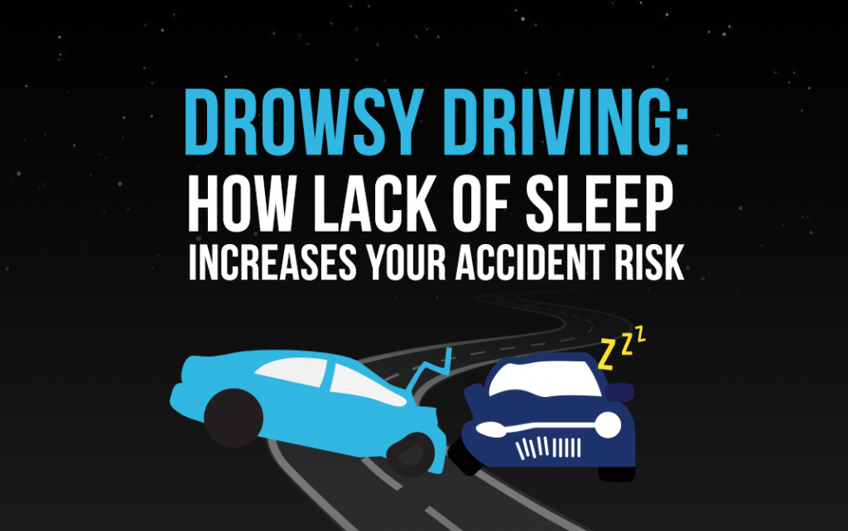

Slide 5
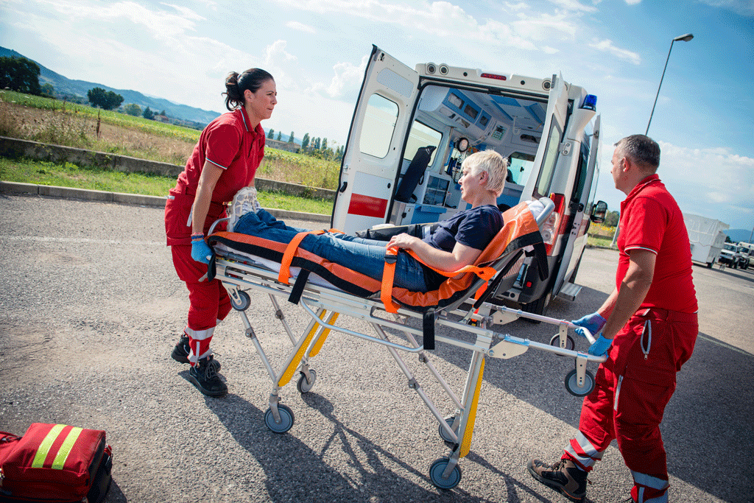
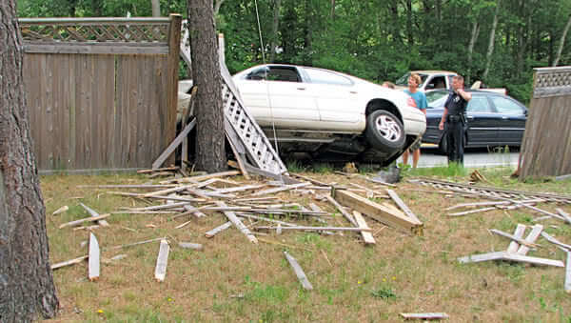
An estimated average of 83,000 accidents involving drowsy driving occurred annually between 2005 and 2009, according to the National Highway Traffic Safety Administration (NHTSA), and some estimates are even higher.
These accidents cost lives, cause injuries, and damage property.
https://theforum.sph.harvard.edu/events/asleep-at-the-wheel/

Slide 6
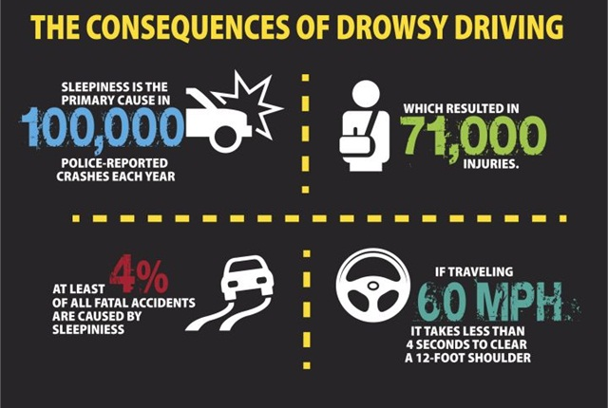

Slide 7

PRECISE NUMBERS OF DROWSY-DRIVING CRASHES, INJURIES, AND FATALITIES ARE HARD TO NAIL DOWN
Unfortunately, determining a precise number of drowsy-driving crashes, injuries, and fatalities is not yet possible.

Slide 8
Crash investigators can look for clues that drowsiness contributed to a crash, but these clues are not always identifiable or conclusive.
https://pict.edu/

Slide 9
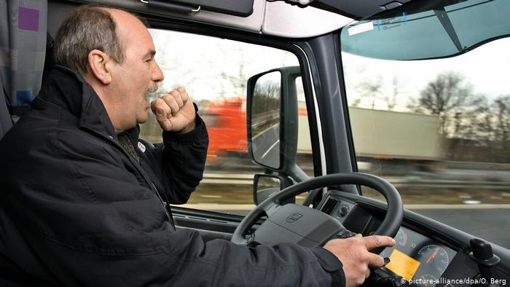
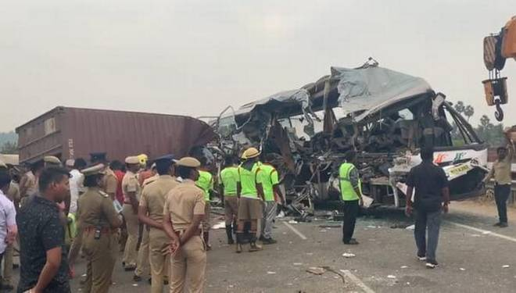

Slide 10

NHTSA- National Highway Traffic Safety Administration
NHTSA’s census of fatal crashes and estimate of traffic-related crashes and injuries rely on police and hospital reports to determine the incidence of drowsy-driving crashes. NHTSA estimates that in 2017, 91,000 police-reported crashes involved drowsy drivers.
https://www.nhtsa.gov/risky-driving/drowsy-driving

Slide 11

NHTSA- National Highway Traffic Safety Administration
These crashes led to an estimated 50,000 people injured and nearly 800 deaths. But there is broad agreement across the traffic safety, sleep science, and public health communities that this is an underestimate of the impact of drowsy driving.
https://www.nhtsa.gov/risky-driving/drowsy-driving

Slide 12

What about India?
There are truck drivers, cab drivers, etc who start their day at 5 in the morning and end it late at night. Still the have to wake up at 5 the next day. This makes them fatigued and sleep deprived perennially.
Each year, around 1.5 lakh people die in road mishaps in India Read more at: http://timesofindia.indiatimes.com/articleshow/67098413.cms?utm_source=contentofinterest&utm_medium=text&utm_campaign=cppst

Slide 13
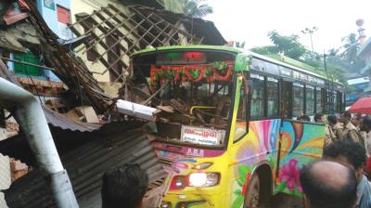
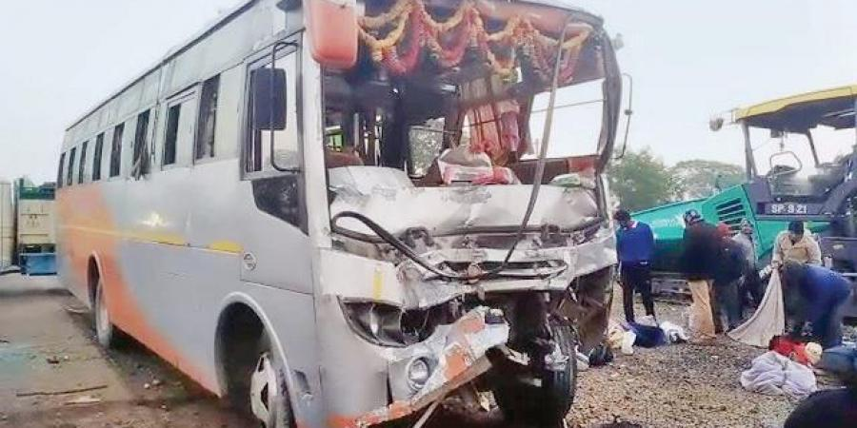
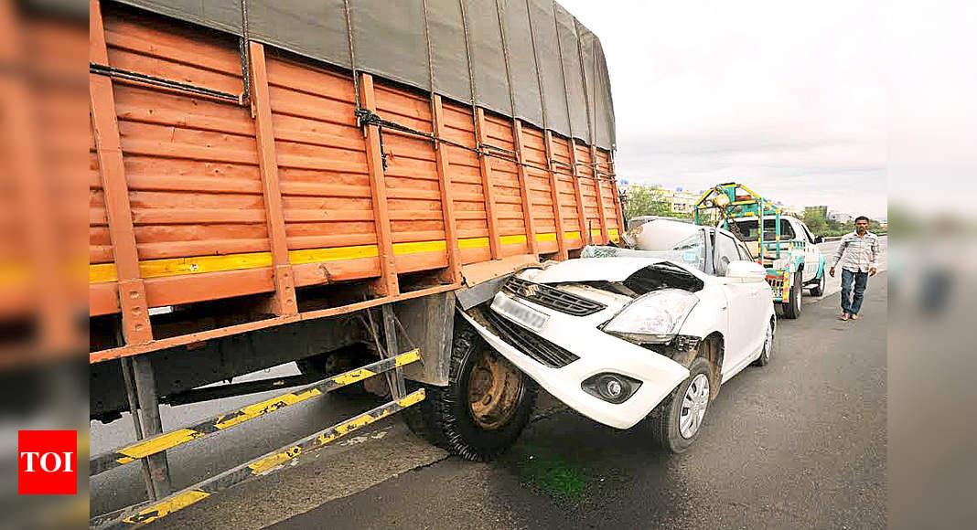
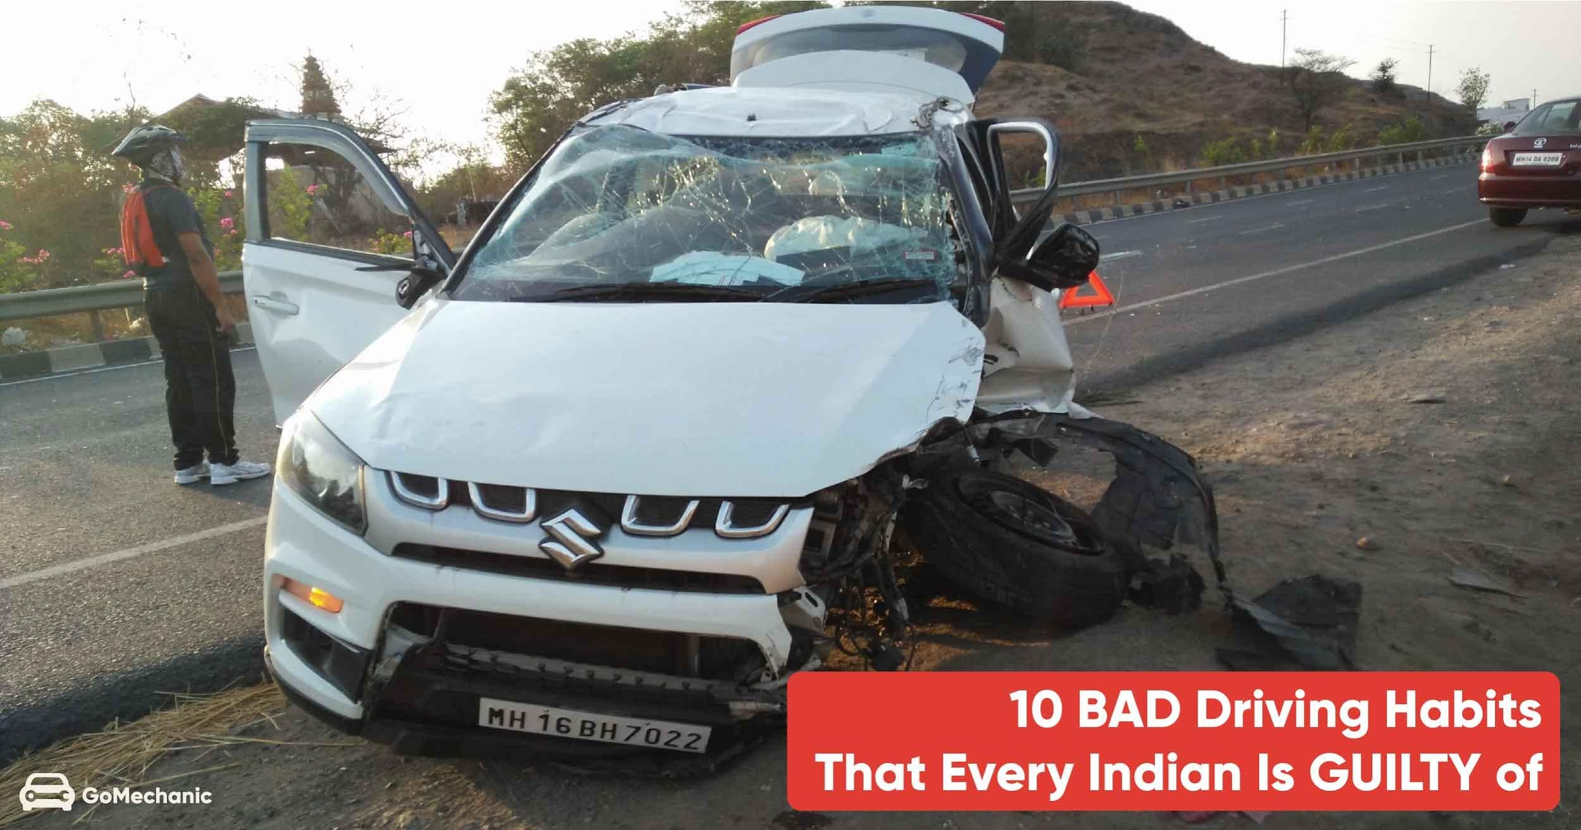
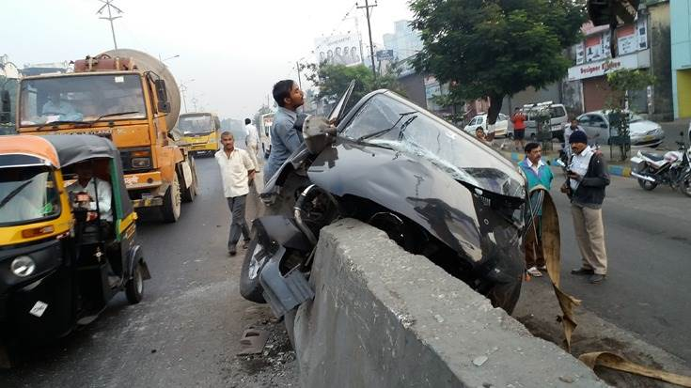

Slide 14
LITERATURE SURVEY -
In [1], it portrays a productive strategy for drowsiness recognition by three characterized stages. These three stages are facial highlights discovery utilizing Viola Jones. When the face is distinguished, the framework is made light invariant by fragmenting the skin part alone by considering just the chromatic segments. The following of eyes and yawning recognition are finished by relationship coefficient layout coordinating.
Once the detection algorithm has successfully detected a face and, subsequently, the eyes, it focuses on determining in what state the eyes are (closed or open). The proposed system monitors if the driver’s eyes are being closed for prolonged period of time. If that is the case, it concludes that the driver might be experiencing signs of drowsiness.
NOTE: [1], [2], [3], [4] are the referred to slide number 25

Slide 15
LITERATURE SURVEY -
The classification method implemented in the system uses data from the setup stage as training data that is applied to a 2-class Support Vector Machine (SVM).
In [2], the use of the image processing is done to determine driver states. From the image of the face it is detected if the driver is awake or asleep. The technique of the behavior of the eyes, calculates the blinking frequency and the time interval of eyes closing in order to determine the rate of drowsiness
PERCLOS (Percent of the time Eyelids are Closed) index is used which measures the percentage of time a person's eyes are closed at 80% to 100% in a period.
Perclose = (Closed eyes time /(closed eyes time + open eyes time))*100
NOTE: [1], [2], [3], [4] are the referred to slide number 25

Slide 16
LITERATURE SURVEY -
The Yawning technique is based on the driver's yawn frequency. The mouth is compared with a reference point experimentally obtained by the programmer and the number of times the driver has yawned is calculated to generate a drowsiness index.
In [3], The first point of venture is to utilize the retinal reflection as it implies to finding the eyes on the confront, and after that utilizing the nonappearance of this reflection as a way of identifying when the eyes are closed.
Applying this calculation on sequential video outlines help within the calculation of eye closure period. Eye closure period for lazy drivers are longer than ordinary blinking.
NOTE: [1], [2], [3], [4] are the referred to slide number 25

Slide 17
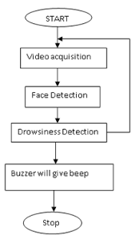
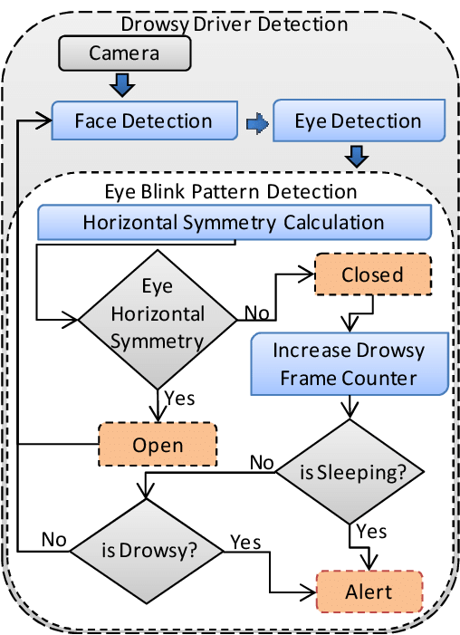
FLOWCHART:

Slide 18

ADVANTAGES
Algorithmically simple and easy to implement.
Easily available on different platforms.

Slide 19

Robustness : The system must be tolerant to modest amounts of lighting variations, relative camera motion (e.g. due to poor road conditions),changes to the driver’s visual appearance (even in the course of a session, e.g., by wearing/removing hat or sunglasses), camera resolution and paramerates, and different computational capabilities of the device’s processors.

Slide 20
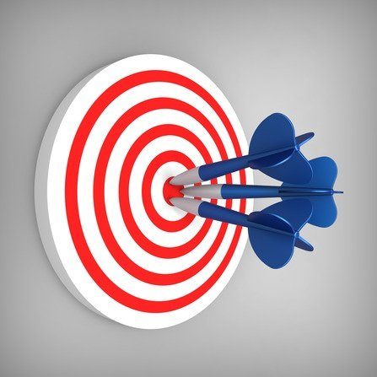
Accuracy : One of the main challenges of designing such a system is related to the fact that errors are highly undesirable.

Slide 21


Computationally non-intensive : Since (near) real time performance is required, algorithms must be optimized.
Simple to use.
Should be quick i.e. real time performance required and delay is undesirable.

Slide 22
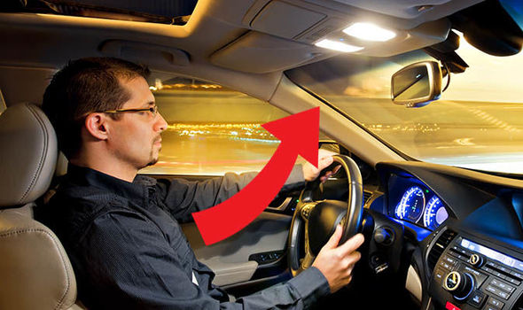
System Requirements
Good lighting conditions : Frequent and drastic change in darkness or brightness of a scene (or part of it),which may happen even during the shortest driving intervals, have been proven to be a significant challenge for many computer vision algorithms.

Slide 23
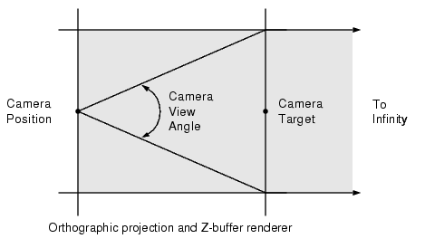
Optimal positioning of the device : The camera must be positioned within a certain range from the driver and within a certain viewing angle. Every computer vision algorithm has a “comfort zone” in which it performs the best and most reliably. If that comfort zone is left, performance can bedropped significantly.

Slide 24

Driver cooperation : A driver drowsiness detection systems assume a cooperative driver, who is willing to assist in the setup steps, keep the monitoring system on at all times, and take proper action when warned by the system of potential risks due to detected drowsiness.

Slide 25

Camera motion : Vibrations due to poor road conditions can be passed onto the camera and cause distortion in the images which can significantly skew the results and decrease the overall performance of the system.

Slide 26

Hardware and software limitations : Typical mobile devices have one or two processor cores, reduced working memory and tend to work on lower clock frequencies, compared to their desktop counterparts.

Slide 27


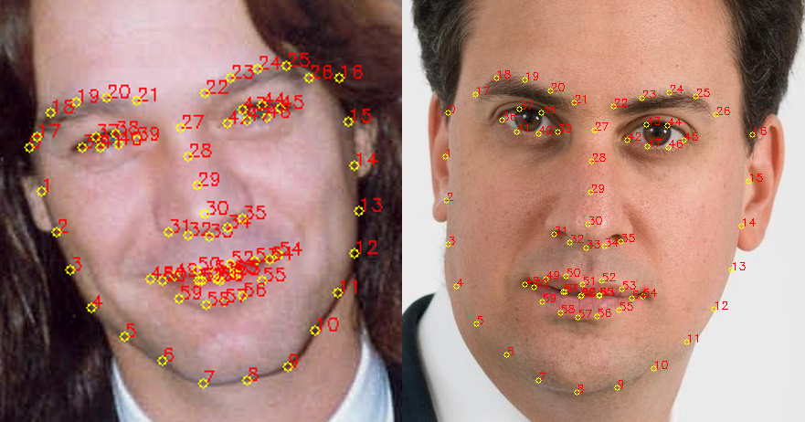
TECH STACK
Python
Dependencies
cv2
imutils
dlib
scipy

Slide 28
References -
[1], Aleksandar Coli´c, Oge Marques and Borko Furht, Design and Implementation of a Driver Drowsiness Detection System A Practical Approach
[2], Eddie E. Galarza1,1 , Fabricio D. Egas1 , Franklin M. Silva1 , Paola M. Velasco1 , Eddie D. Galarza1 , 1 Universidad de las Fuerzas Armadas – ESPE, Real Time Driver Drowsiness Detection Based on Driver’s Face Image Behavior Using a System of Human Computer Interaction Implemented in a Smartphone.
[3], Aayushi Ahlawat, Simran Kaur, Sejal Rana. Drowsiness Detection System Using OpenCV, International Journal of Creative and Research Thoughts.

Slide 29
print(“THANK YOU!”)

